Slide 1
Office of Research and Development
(ORD)
Aug./2024

Slide 2
Responsibilities of Division of Research Coordination (DRC)
Research Project Application
Government projects
NSTC research projects
Projects hosted by MOE and other government agencies
Intramural project subsidies
Research subsidy for new faculty members
Subsidy for international collaboration research projects
Subsidy to Short-Term Abroad Research Project of Assistant Professors
National Taiwan University System
Innovation-Oriented Trilateral Proposal for Young scholars of National Taiwan University System
English paper editing
Paper publication
Attend international conferences
Paper and Book publication reward
Academic
Subsidies and Awards
Intramural subsidies and awards
Host international conferences
Art Exhibition & performance
Transdisciplinary team formation
Academic awards
Off-campus academic awards
Intramural research excellence awards
Empowerment
Research consultation subsidy
Academic research capacity enhancement activities
MOU of domestic academic research institutions

Slide 3
Research project application
(1/6)
Projects for new researchers (first come, first served)
Those who have never applied for the NSTC projects can only apply once
Application must be submitted within three years from the day of employment or the first three years starting from the date received the doctoral degree or the first three years of a qualified NSTC PI
NSTC research projects
Annual application
Apply by the end of December each year
Individual solicitation
Please refer to the application information announced on the ORD website and ORD e-paper
For the application deadline of each project, please refer to the announcement by NTNU on the ORD website and e-paper
Application procedure
Visit the NSTC website
and complete the application
Fill out the academic ethics education course checklist
Submit the checklist to the case officer of PI’s respective department, and inform the department online to confirm the case
The departments shall compile the applicant lists and checklists and submit them to ORD
ORD-Compile the project documents and submit them to the NSTC

Slide 4
Research project application
(2/6)
NSTC research projects
How to apply for an NSTC account
Please visit the NSTC website (https://www.nstc.gov.tw/) and submit an application.
https://arspb.nstc.gov.tw/NSCWeb/modules/WEB/NewRegister.do?action=step1&LANG=eng
*All NSTC project applicants must submit the academic ethics education course checklist
*Applicants who host and participate in NSTC projects for the first time must complete a 6-hour academic ethics education course within three years before to the application for NSTC projects (Note:The academic research ethics education course credits are different from the human research ethics course credits)
Please visit the Center for Taiwan Academic Research Ethics Education website to explore elective courses (https://ethics.moe.edu.tw/ )
When registering for elective courses, faculty members must register individually by signing up for an account themselves.
Please provide proof of academic ethic education course credits
How to subscribe to the ORD e-paper
Please visit the ORD website and e-paper subscription site for more information : https://www.acad.ntnu.edu.tw/zh_tw/epapers
Standard operating procedure (SOP)
  Please refer to the ORD website at https://www.acad.ntnu.edu.tw/zh_tw/ord/1page301/1page301_1

Slide 5
Research project application
(3/6)
Institutional Review Board: Human research ethics course credits are different from academic ethics education course credits
Relevant law: Paragraph 4, Article 11, Directions governing NSTC subsidies for research projects
1. Research projects involving human testing, or collection of human specimens, embryos, or embryonic stem cells require the attachment of documents approved by the medical ethics committee or the institutional review board. Projects involving gene recombination require the attachment of the consent form for conducting gene recombination experiments approved by the biosafety committee. Projects involving field trials for gene transfer require the attachment of documents approved by the competent authority. Projects involving animal experiments require the attachment of documents approved by the Institutional Animal Care and Use Committee. Projects involving testing of infectious substances of Level 2 or higher require the attachment of documents approved by related departments. If the documents of approval cannot be submitted during the application, the documents for review must first be submitted, and the documents of approval must be added within six months after the application.
2. Research projects by the NSTC Department of Humanities and Social Sciences involving systematic investigations or professional academic knowledge exploratory activities focusing on individuals or groups through interventions, interactions, or use of data that can be used to identify specific parties require the attachment of documents of approval submitted to the research ethics committee for review before the project begins.
Please contact the NTNU Center for Research Ethics for matters related to research ethics review

Slide 6
Research project application
(4/6)
NSTC 2030 Cross-Generation Young Scholars Program- Information regarding the types of projects involved with this program was added since 2021
*Worked as teaching and/or research faculty members domestically or abroad for no longer than five years or acquired Ph.D. degrees within five years prior to the application
*Approved for 25 projects per year, with each project subsidized no more than NT$5,000,000
*Allowance for PI： NT$30,000 per month
Types
Emerging Young Scholars
Excellent Young Scholars
*Must be under 45 years of age, and having worked in academic research institutions in Taiwan
*Approved for a certain number of new projects and a certain amount of subsidies each year in accordance with the results of the review
*Allowance for PI ：NT$15,000 per month
International Outstanding Young Scholars
* Must be under 45 years of age and possess exceptional performance in international independent research , qualifications, and international team formation domestically and abroad.
*Approved for 15 projects per year, with each project subsidized no more than NT$10,000,000
*Allowance for PI ：NT$50,000 per month
Application time
2024: To announced by NSTC
(2023: Approximately the same as the Annual application delivery time for the year)

Slide 7
Research project application
(5/6)
Projects funded by government agencies outside of NSTC
Solicitation by Official Document
See the application information published on the ORD website, ORD e-paper, and NTNU e-bulletin
Individual bid
See the tender announcements on the websites of the ORD or government agencies
Negotiate with the agencies separately
or
*The application deadlines for projects requiring unified delivery by NTNU are subject to announcements by NTNU
*The documents required for the bid are processed in accordance with the tender regulations announced by each agency
Application procedure
For applications requiring unified delivery by NTNU
All required documents should be prepared in accordance with the announcements of the soliciting units
Submit all required documents
by the announced deadlines
The documents shall consolidated and delivered by the responsible units of the NTNU
For applications not requiring unified delivery by the NTNU
The implementation unit must prepare all application documents
Apply to relevant NTNU processing units with an official document
Submit the project directly by document or bid

Slide 8
Research project application
(6/6)
Projects funded by government agencies outside of NSTC
For bids that require Certificate from Registered/Accredited Universities
Please visit the Office of Academic Affairs website https://www.aa.ntnu.edu.tw/zh_tw/Registry/Application/filingcase
For bids that require tax-free certificates
For tax-free certification and type 1 check credit inquiry please contact the Cashier section of the Office of General Affairs
Download the table at :http://www.ga.ntnu.edu.tw/cas/index.aspx
Application Form on Administrative Fee Supplement Methods for Commission / Subsidy Project Budget
Please refer to the Office of Research and Development website
https://www.acad.ntnu.edu.tw/zh_tw/drc/3page2
SOP (including the table of hierarchical responsibilities for legal documents)
Please refer to the Office of Research and Development website
https://www.acad.ntnu.edu.tw/zh_tw/drc/3page2

Slide 9
Intramural subsidies and awards(1/5)
Team organization
Subsidy for promoting the organization of interdisciplinary teams by the faculty
Paper editing
Subsidy for English paper editing services
Case-by-case Review
Paper publication fee
Subsidy for the publication of original academic papers
New faculty
*Subsidy to new faculty members for publishing papers in international conferences abroad
Attending international conferences
*Subsidy to faculty for attending top international conferences abroad
*Subsidy to Ph.D. students for publishing papers in international conferences
Hosting international conferences
*Subsidy for Convention of International Conference and Seminar
*Subsidy for hosting top international conferences
*Subsidies for international conferences must be applied for at least 5 weeks before the conference commences

Slide 10
Intramural subsidies and awards(2/5)
March and September
New faculty
Subsidy for research project for new faculty members
Subsidy for promoting art performances or exhibitions
Subsidy for hosting international conferences domestically
Fixed schedules
August
Subsidy for international collaboration research projects
(applications accepted by the end of August each year; see the announcements on the ORD website)
Academic Paper and Book Rewards
(applications accepted in October of each year for academic papers and books published in the previous year)
Applicants for book rewards must first complete the review process; the review process requires approximately 3 months; please complete the process in advance
October
Annual announcements
  Innovation-Oriented Trilateral Proposal for Young scholars of National Taiwan University System
  (Applications are accepted in accordance with the dates announced by ORD each year)

Slide 11
Intramural subsidies and awards(3/5)
Regulation
National Taiwan Normal University Implementation Guidelines for Assistance in Research and Consultation of Outstanding Professors
  Goal
To provide consultation to faculty members in writing NSTC projects
Research Consultation
  Complete the research consultation request form and submit it to the contact in the consultation division of each academic department to assist in providing consultation to faculty members in similar fields of research. Independently seeking out consultant is also viable.
  Implementation Method
  Provisions to new faculty members
New faculty members are required to apply for research consultation at least once within one year after the start of their employment. It shall be listed as a reference in the new faculty member evaluation.
  List of contacts in the consultation divisions
  Please refer to the Office of Research and Division website
  https://www.acad.ntnu.edu.tw/zh_tw/ord/1page501

Slide 12
Intramural subsidies and awards(4/5)
Regulation
National Taiwan Normal University Research Excellence Reward Regulations
  Recipients
NTNU faculty members who have won the following major academic research awards：
Presidential Science Prizes, Executive Yuan Award for Outstanding
Science and Technology Contribution, National Award for Arts,
National Cultural Award (Executive Yuan), Academic Award (MOE),
National Professorship Award(MOE), Outstanding Scholar Award
(Foundation For The Advancement of Outstanding Scholarship),
Outstanding Achievement Award (Hou Chin-Dwei Foundation),
Outstanding Research Award (NSTC), Ta-You Wu Memorial Award
(NSTC), Research Fellow Award (NSTC), Award for Excellent
Contributions in Technology Transfer (NSTC), or Academia Sinica
Early-Career Investigator Research Achievement Award.
Research excellence award
  Content of the award
NT$100,000 for each recipient for reimbursement, verified in accordance with the NTNU accounting regulations

Slide 13
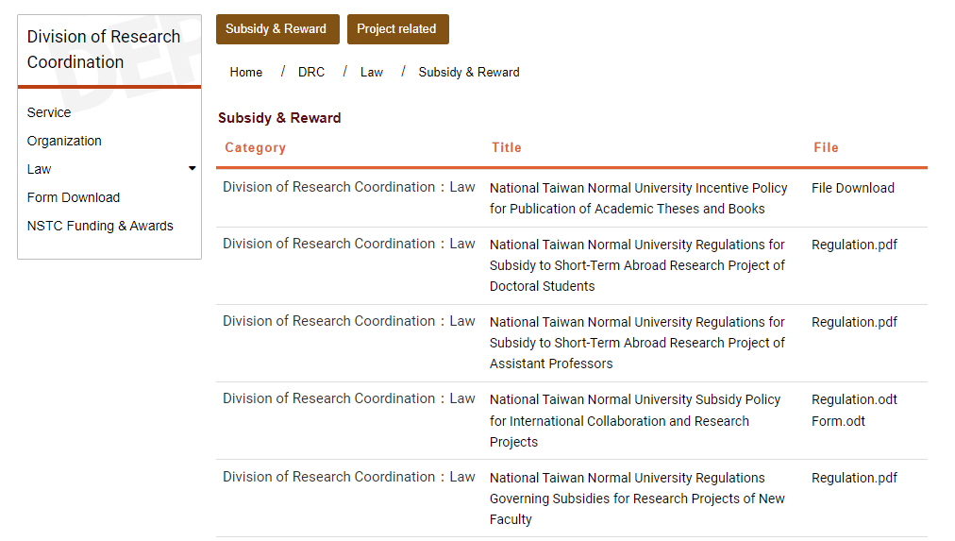
Intramural subsidies and awards(5/5)
Subsidy and award regulation inquiry
Please refer to the Office of Research and Development website for regulations related to subsidies and awards
https://www.acad.ntnu.edu.tw/en/drc/3reg/3reg1

